Slide 1

Spectre and Meltdown
How they work
Bob Flanders
Tech Day, February 2017

Slide 2
Spectre and Meltdown: What are they?
Spectre is the name applied to attacks on a system that use speculative execution to steal information from peer processes.
Spectre induces a victim to speculatively execute transient instructions that would not occur during correct program execution resulting in a leak of the victim’s confidential information using a covert side channel that is read by the attacker’s software.
Spectre is difficult to implement because it must tailor the software environment of the victim process.
Meltdown is the name applied to attacks on systems that use out-of-order execution to steal information from an OS system kernel.
Meltdown executes code as a user that causes the processor to execute out-of-order instructions which cause the desired data to be loaded into the processors cache.
Meltdown is relatively easy to implement because it’s target is kernel memory.
Notes:
https://www.usenix.org/node/184416
https://spectreattack.com/spectre.pdf
https://meltdownattack.com/meltdown.pdf
https://danielmiessler.com/blog/simple-explanation-difference-meltdown-spectre/

Slide 3
Spectre and Meltdown: Before we start
In order to discuss these attacks there are a several things you need to know:
CPU privilege architecture (Rings)
X86 Virtual Memory Architecture
Memory Protection
Other CPU Architectural Tidbits
Covert Side Channels
Then we can talk about Meltdown and Spectre.

Slide 4
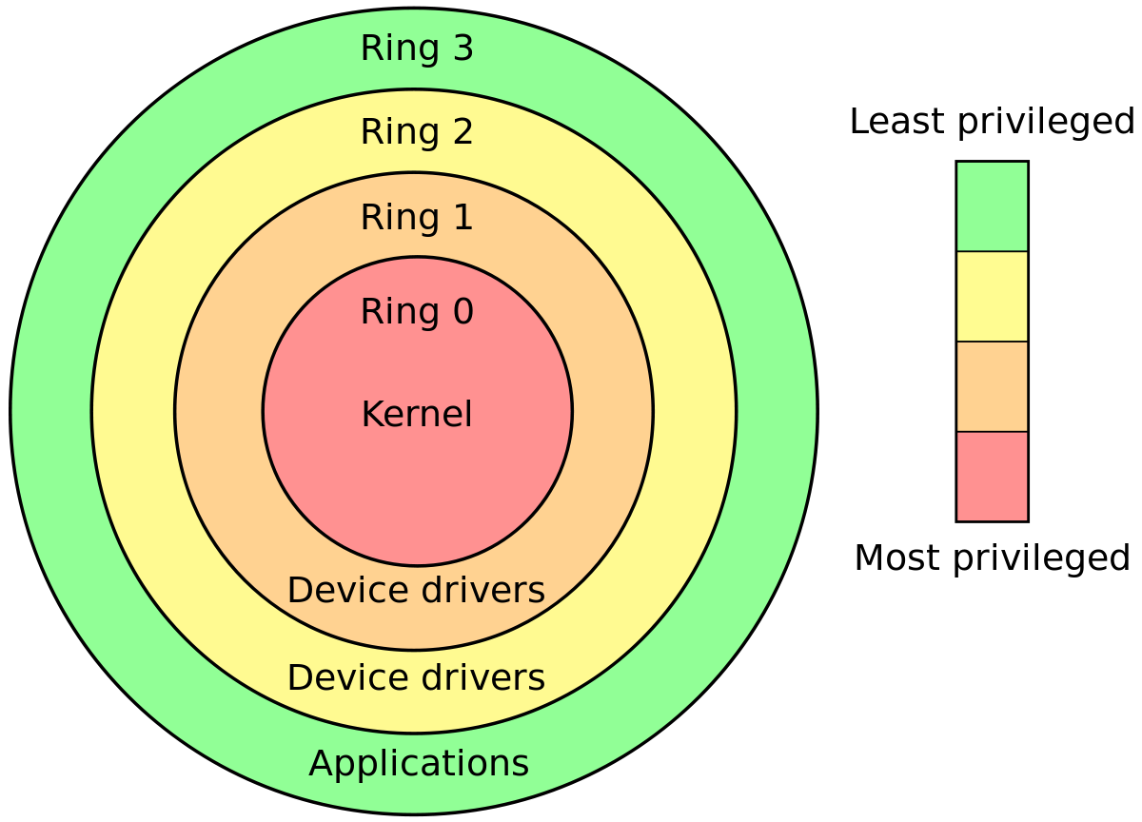
CPU privilege architecture (Rings)
When a program executes on an X86 CPU, it run in a “Ring”
The ring defines what instructions the program may execute
Memory access is limited by the current process’ ring.
Your applications run in Ring 3 with the least privilege (from a CPU point of view).
Ring 3 program cannot directly access Ring 0 memory.
So why can’t one application access another application’s memory? Virtual memory!

Slide 5
X86 Virtual Memory Architecture
Virtual memory is memory that appears to exist as main storage but may actually be located on disk.
Allows a computer to run use more than memory that is physically in the machine.
Works by using a set of tables that translate a virtual address to a real address.
If a page of virtual memory is not physically present, an interrupt occurs that tells the OS to load the virtual page into real memory, possibly displacing another page.
Each application has it’s own page tables.
The Kernel has it’s own page tables. These pages are mapped into Application space but marked as inaccessible.

Slide 6
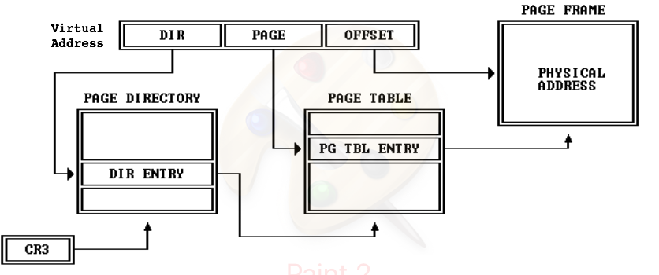
X86 Virtual Memory Architecture
How it works:
Hardware register CR3 points at the top-level page table
A virtual address is broken into sets of bits
The first N bits indicate the entry in the top-level table, which points to a second—level table.
Then next N bits indicate the entry in the second level table that contains a page table entry which points to the page frame in real memory.
The last N bits indicate the offset in the page frame.
There can be more levels and different page frame sizes, but this gets the idea across.
The page table entry contains bits that indicate which ring may access the page, if the page is in memory and if the page is dirty. The Ring access is most important for this discussion.

Slide 7
X86 Virtual Memory Architecture
But Bob, that seems slow... Does the system have to do that address translation every time???
Fortunately, no. There is an internal table on the CPU called the Translate Lookaside Buffer (TLB)
It contains virtual and real addresses from recent address translations along with the relevant page table entry.
If a virtual address is in the TLB, no address translation is needed.
It also keeps instructions from accessing memory inside the cpu.
Is there anything else that speeds the process?
Yes. Memory caching. There are three levels of caches on x64 CPUs, L1, L2 and L3
L1 and L2 caches reside on each core of a cpu and are specific to that core.
L3 is shared by all cores and includes the contents of the core caches.
These caches are very fast. For example, accessing memory can cost 200 CPU clock cycles. L3 access can may be 40 clock cycles, and L1 4 clock cycles.

Slide 8
Memory Protection
How does this all work to protect memory from attacks?
Applications run in Ring 3. The OS kernel runs in Ring 0.
The kernel’s page table entries are set to only allow Ring 0 access. Ring 3 can’t read them because the CPU Hardware will get an access denied exception when it tries to access to virtual address.
What protects one application from reading another’s memory?
Each application has it’s own set of page tables.
An application cannot even attempt to read another app’s memory. There is no entry in it’s page table that “points at” the target memory address.
The privilege system and virtual memory pages protect attackers from reading your memory.
So how do these attacks occur?

Slide 9
Other CPU Architectural Tidbits
Caching and microarchitectural state
When code attempts to access memory, the cache is checked. If the location is cached, access is quick. If not, access is slow. The caching of memory is a change in microarchitectural state.
Speculative and Out of Order execution
Modern CPUs use a pipeline architecture that allow them to make ”guesses” about what will execute next, and speculatively execute the instructions, temporarily storing the results. If the guess was good, the results are committed and become visible to the process. If not, the results are discarded.
During speculative or out-of-order execution, memory may be cached, changing the microarchitectural state of the CPU. This state information will not be discarded.
Further, during speculative execution, the protection from reading protected memory (kernel memory) is not enforced although the result of the read will be discarded when the access exception is discovered by the CPU.
Applications can flush the cache
There are ways to flush cache lines from a non-privileged application.

Slide 10
Covert Side Channels
Using this information about architecture, consider this scenario:
An application has two parts. A sender and a receiver. The point is to send a single bit of information. The sender is a forked process.
An application trains the CPU to run code out-of-order. It then flushes some lines of cache.
On behalf of the sender CPU executes the trained out-of-order code which loads a byte from kernel memory and tests a bit. (Remember, during out-of-order execution, memory access is not enforced and the kernel memory is mapped for the application.) If the bit checked is one, loads one line of cache and if zero, the other.
When the CPU goes to commit the results of the code, it then realizes that access was not allowed, discards the result of the code and kills the sender process. But the micro-architectural state remains: the cache line has been loaded
The receiver tests which line of cache has quick access time and thereby determines if the bit was one or zero. A bit of the kernel has now been transferred to a non-kernel process.
This methodology is known as a covert side channel. The information has been transmitted and received through normal CPU activity.

Slide 11
So, What are Spectre and Meltdown?
Spectre and Meltdown are attacks that use covert side channels to transmit information from one process to another.
Meltdown attacks the kernel. Since the kernel address space is mapped into the applications, it just has to defeat the CPU’s protections.
Meltdown most strongly affects Intel processors because of the aggressive way they handle speculative execution, though a few ARM cores are also susceptible. AMD, so far, is not susceptible to meltdown.
It is more serious because it breaks down the isolation between kernel and application.
“Spectre breaks the isolation between different applications. It allows an attacker to trick error-free programs, which follow best practices, into leaking their secrets. In fact, the safety checks of said best practices actually increase the attack surface and may make applications more susceptible to Spectre” – Google Project Zero
Spectre is far more difficult to implement. It must find an instruction sequence that will act as the sender on a covert channel, then trick the CPU into executing the instructions speculatively within the victim’s process.

Slide 12
Conclusions
Spectre and Meltdown represent the culmination of findings that started as far back as 1993 where microarchitecural state was recognized as a way to indirectly note CPU activity.
This presentation only provides an overview of the information about how CPUs work and the methodologies used by Specter and Meltdown. I have many links that provide both shallow and deep presentations of these subjects.
Thank you!

